Slide 1

NIO - > New I/O

Slide 2
Group Members
Muhammad Hamad (12-f-12)
Muhammad Usman Javed (12-f-09)
Malik Kamran Hafeez (12-f-72)

Slide 3
What we will cover ?
What is I/O ?
What is NIO ?
Why NIO ?
Channels and Buffers
Channels explanation and its types
How buffers work ? , Buffer internals , Types of Buffer , Put and get data from buffers e.t.c
Networking and asynchronous I/O
Selectors
Server Socket Channels
Selection Keys
How Issue of multi threading on server end is resolved ?

Slide 4
What is I/O ?
I/O -- or input/output -- refers to the interface between a computer and the rest of the world, or between a single program and the rest of the computer.
In Java programming, I/O has until recently been carried out using a stream metaphor.
All I/O is viewed as the movement of single bytes, one at a time, through an object called a Stream.
Stream I/O is used for contacting the outside world. It is also used
Internally, for turning objects into bytes and then back into objects.

Slide 5
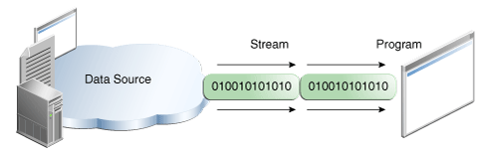
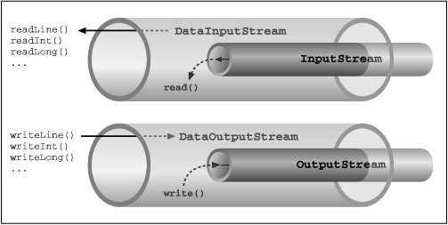

Slide 6
What is NIO ?
Alternative to standard java I/O
An API for scalable I/O, fast buffered binary I/O, and an improved filesystem interface.
The most important distinction between the original I/O library (found in java.io.*) and NIO has to do with how data is packaged and transmitted.
NIO was created to allow Java programmers to implement high-speed I/O without having to write custom code.

Slide 7
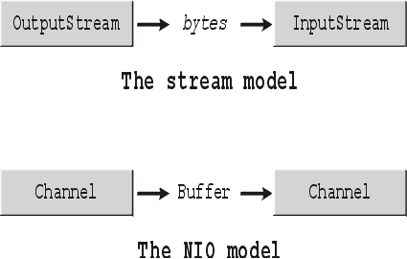

Slide 8
Streams versus blocks
A stream-oriented I/O system deals with data one byte at a time. An input stream produces one byte of data, and an output stream consumes one byte of data.
A block-oriented I/O system deals with data in blocks. Each operation produces or consumes a block of data in one step. Processing data by the block can be much faster than processing it by the (streamed) byte.

Slide 9
Buffers
A Buffer is an object, which holds some data, that is to be written to or that has just been read from.
In stream-oriented I/O , you wrote data directly to, and read data directly from, Stream objects.
In the NIO library, all data is handled with buffers. When data is read, it is read directly into a buffer. When data is written, it is written into a buffer.
Anytime you access data in NIO, you are pulling it out of the buffer.
A buffer is essentially an array. Generally, it is an array of bytes, but other kinds of arrays can be used.

Slide 10
Kind of Buffers
Byte Buffer is not the only type of buffer in NIO. In fact, there is a buffer type for each of the primitive Java types:
CharBuffer
ShortBuffer
IntBuffer
LongBuffer
FloatBuffer
DoubleBuffer

Slide 11
Channels
A Channel is an object from which you can read data and to which you can write data.
Comparing NIO with original I/O, a channel is like a stream
You never write a byte directly to a channel; instead you write to a buffer containing one or more bytes.
Likewise, you don't read a byte directly from a channel; you read from a channel into a buffer, and then get the bytes from the buffer

Slide 12
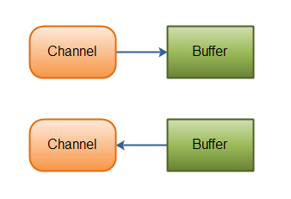

Slide 13
Kinds of Channels
File Channel (reads data from and to files)
Datagram Channel (can read and write data over the network via UDP)
Socket Channel (can read and write data over the network via TCP)
ServerSocketChannel (allows you to listen for incoming TCP connections)

Slide 14
Reading and writing in NIO
Reading from a channel is : we simply create a buffer and then ask a channel to read data into it.
Writing into a channel is: we create a buffer, fill it with data, and then ask a channel to write

Slide 15
Reading in NIO
Any time you perform a read operation in an NIO system, you are reading from a channel, but you don't read directly from a channel. Since all data ultimately resides in the buffer, you read from a channel into a buffer.
Steps involved in reading :
Get the channel from input stream
FileInputStream fin = new FileInputStream( "readandshow.txt" );
FileChannel fc = fin.getChannel();
Create the buffer
ByteBuffer buffer = ByteBuffer.allocate( 1024 );
Reading from the Channel into the Buffer
fc.read( buffer );

Slide 16
Writing in NIO
Steps involved in reading :
Get the channel from output stream
FileOutputStream fout = new FileOutputStream( "writesomebytes.txt" );
FileChannel fc = fout.getChannel();
Create buffer and put some data in it
ByteBuffer buffer = ByteBuffer.allocate( 1024 );
for (int i=0; i<message.length; ++i) {
buffer.put( message[i] );
}
buffer.flip(); // prepares the buffer to have the newly-read data written to another channel
Write this buffer to channel
fc.write( buffer );

Slide 17
Buffer internals
Two important components of buffers in NIO
State Variables
Position
Limit
Capacity
Accessor methods
get()
put()

Slide 18
State Variables
Position
keeps track of how much data you have written. More precisely, it specifies into which array element the next byte will go.
Limit
specifies how much data there is left to get (in the case of writing from a buffer into a channel), or how much room there is left to put data into (in the case of reading from a channel into a buffer)
Capacity
specifies the maximum amount of data that can be stored in the buffer

Slide 19
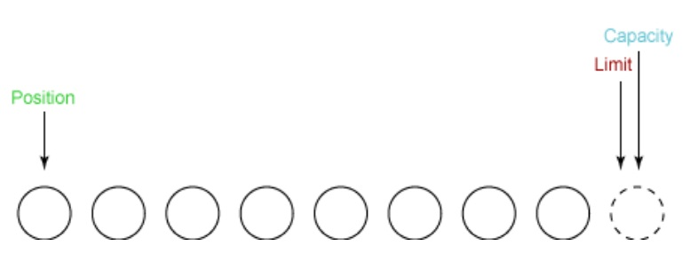
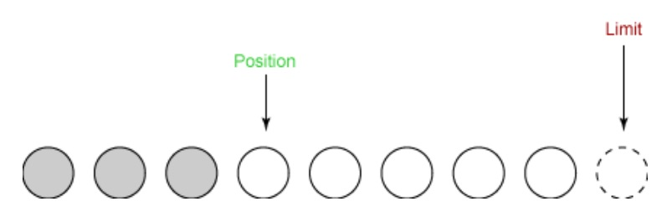

Slide 20
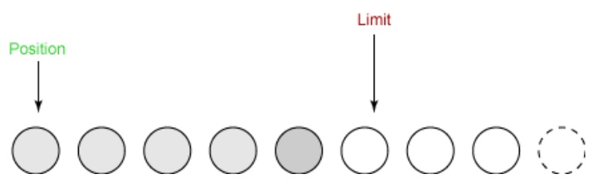
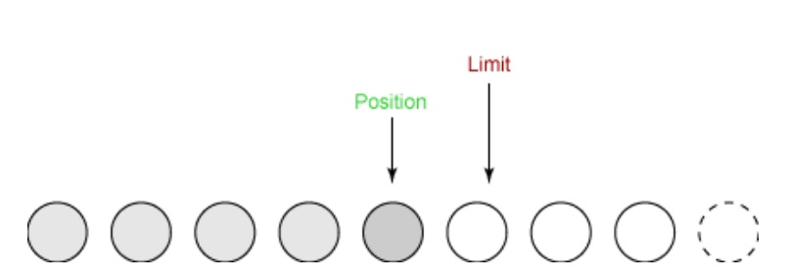
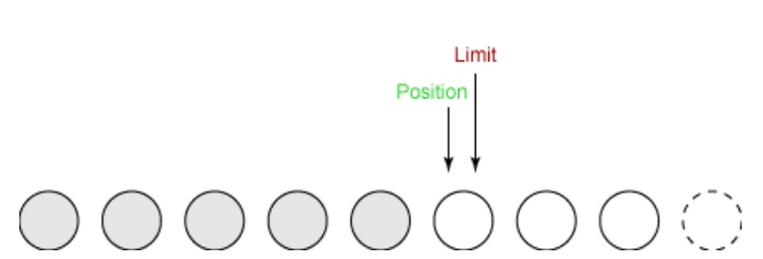
buffer.flip();

Slide 21
Accessor methods
getByte() ,putByte()
getChar() ,putChar()
getShort() putShort()
getInt() ,putInt()
getLong() ,putLong()
getFloat() , putFloat()
getDouble() ,putDouble()

Slide 22
More about buffers
Buffer wrapping
Byte array[] = new byte[1024];
ByteBuffer buffer = ByteBuffer.wrap( array );
Read-only buffers
Turn any regular buffer into a read-only buffer by calling itsasReadOnlyBuffer()

Slide 23
Asynchronous I/O
Asynchronous I/O is a method for reading and writing data without blocking.
When your code makes a read() call, the code blocks until there is data to be read . Likewise, a write() call will block until the data can be written.
Asynchronous I/O calls, on the other hand, do not block. Instead, you register your interest in a particular I/O event -- the arrival of readable data, a new socket connection, and so on -- and the system tells you when such an event occurs.
In asynchronous IO, a thread can request that some data be written to a channel, but not wait for it to be fully written. The thread can then go on and do something else in the mean time.

Slide 24
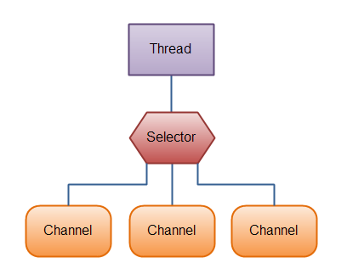
Selectors
A Selector is a Java NIO component which can examine one or more NIO Channel's, and determine which channels are ready for e.g. reading or writing. This way a single thread can manage multiple channels, and thus multiple network connections.
A Selector is where you register your interest in various I/O events, and it is the object that tells you when those events occur.

Slide 25
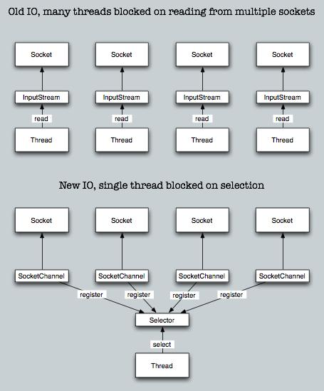

Slide 26
Creating a Selector
Selector selector = Selector.open();
Registering Channels with the Selector
channel.configureBlocking(false);
SelectionKey key = channel.register(selector, SelectionKey.OP_READ);
SelectionKey.OP_CONNECT
SelectionKey.OP_ACCEPT
SelectionKey.OP_READ
SelectionKey.OP_WRITE
A channel that "fires an event" is also said to be "ready" for that event.
So, a channel that has connected successfully to another server is "connect ready".
A server socket channel which accepts an incoming connection is "accept" ready.
A channel that has data ready to be read is "read" ready.
A channel that is ready for you to write data to it, is "write" ready.
Opening a ServerSocketChannel
In order to receive connections, we need a ServerSocketChannel.
ServerSocketChannel ssc = ServerSocketChannel.open();
ssc.configureBlocking( false);
ServerSocket ss = ssc.socket();
InetSocketAddress address = new InetSocketAddress( ports[i] );
ss.bind( address );

Slide 27
while (true) {
// Selects a set of keys whose corresponding channels are ready for I/O operations.
int num = selector.select();
Set selectedKeys = selector.selectedKeys();
Iterator it = selectedKeys.iterator();
while(it.hasNext()){
SelectionKey key = (SelectionKey) it.next();
// remove the key so that we don't process this OPERATION again.
it.remove();
// key could be invalid if for example, the client closed the connection.
if (!key.isValid()){
continue;
}
//In the server, we start by listening to the OP_ACCEPT when we register with the Selector. If the key from the keyset is Acceptable, then we must get ready to accept the client connection .
if (key.isAcceptable()){
System.out.println("Accepting connection");
accept(key);
}
// If you already read the comments in the accept() method, then you know we changed the OPERATION to OP_WRITE. This means that one of these keys in the iterator will return a channel that is writable (key.isWritable()).
if (key.isWritable()){
System.out.println("Writing...");
write(key);
}
if (key.isReadable()){
System.out.println("Reading connection");
// read(key);
}
}
}

Slide 28
Methods to accept connection request
/**
* Since we are accepting, we must instantiate a serverSocketChannel by calling key.channel().
* We use this in order to get a socketChannel (which is like a socket in I/O) by calling
* serverSocketChannel.accept() and we register that channel to the selector to listen
* to a WRITE OPERATION. I do this because my server sends a hello message to each
* client that connects to it. This doesn't mean that I will write right NOW. It means that I
* told the selector that I am ready to write and that next time Selector.select() gets called
* it should give me a key with isWritable(). More on this in the write() method.
*/
private static void accept(SelectionKey key) throws IOException{
ServerSocketChannel serverSocketChannel = (ServerSocketChannel) key.channel();
SocketChannel socketChannel = serverSocketChannel.accept();
socketChannel.configureBlocking(false);
SelectionKey kk= socketChannel.register(selector, SelectionKey.OP_WRITE);
}

Slide 29
Methods to write to a channel
/**
* We registered this channel in the Selector. This means that the SocketChannel we are receiving
* back from the key.channel() is the same channel that was used to register the selector in the accept()
* method.
*/
private static void write(SelectionKey key) throws IOException{
SocketChannel channel = (SocketChannel) key.channel();
byte[] h = new String("Hello from server").getBytes();
ByteBuffer bbf=ByteBuffer.wrap(h);
channel.write(bbf);
}

Slide 30
Methods to read from a channel
private void read(SelectionKey key) throws IOException{
SocketChannel channel = (SocketChannel) key.channel();
ByteBuffer readBuffer = ByteBuffer.allocate(1024);
readBuffer.clear();
int read;
try {
read = channel.read(readBuffer);
} catch (IOException e) {
System.out.println("Reading problem, closing connection");
key.cancel();
channel.close();
return;
}
if (read == -1){
System.out.println("Nothing was there to be read, closing connection");
channel.close();
key.cancel();
return;
}
// IMPORTANT - don't forget the flip() the buffer. It is like a reset without clearing it.
readBuffer.flip();
byte[] data = new byte[1000];
readBuffer.get(data, 0, read);
}

Slide 31
Methods to connect to a channel
selector = Selector.open();
channel = SocketChannel.open();
channel.configureBlocking(false);
channel.register(selector, SelectionKey.OP_CONNECT);
channel.connect(new InetSocketAddress("127.0.0.1", 4444));
private void connect(SelectionKey key) throws IOException {
SocketChannel channel = (SocketChannel) key.channel();
if (channel.isConnectionPending()){
channel.finishConnect();
}
channel.configureBlocking(false);
SelectionKey kr= channel.register(selector, SelectionKey.OP_READ);
}

Slide 32
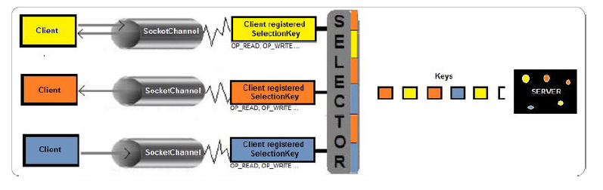
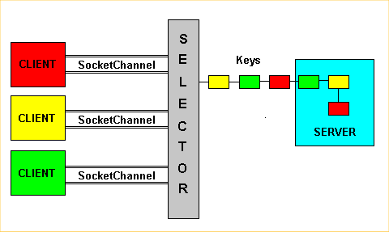

Slide 33
References
ibm.com/developerWorks
Adblogcat.com/Asynchronous Java NIO for dummies
Jenkov.com/nio
OReilly_Java_Network_Programming,_2nd_Edition

Slide 34
Demo…

Slide 35
Thanks…

